Slide 1

Lab3:缺页机制

Slide 2
Lab3主要内容
完成初始化虚拟内存管理机制：IDE 硬盘读写，缺页异常处理
设置虚拟页空间和物理页帧空间，表述不在物理内存中的“合法”虚拟页
完善建立页表映射、页访问异常处理操作等函数实现
执行访存测试，查看建立的页表项是否能够正确完成虚实地址映射
执行访存测试，查看是否正确描述了虚拟内存页在物理内存中还是在硬盘上
执行访存测试，查看是否能够正确把虚拟内存页在物理内存和硬盘之间进行传递
执行访存测试，查看是否正确实现了页面替换算法等
■

Slide 3

处理流程，关键数据结构和功能
■ 关键数据结构 (\kern\mm\vmm.h)
struct vma_struct {
// the set of vma using the same PDT
struct mm_struct *vm_mm;
uintptr_t vm_start; // start addr of vma
uintptr_t vm_end; // end addr of vma
uint32_t vm_flags; // flags of vma
//linear list link which sorted by start addr of vma
list_entry_t list_link;
};

Slide 4
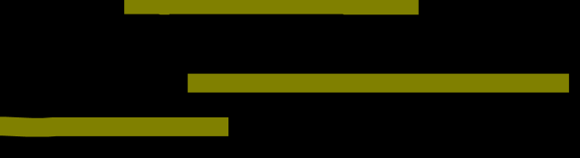
处理流程，关键数据结构和功能
■ 关键数据结构 (\kern\mm\vmm.h)
struct mm_struct {
// linear list link which sorted by start addr of vma
list_entry_t mmap_list;
// current accessed vma, used for speed purpose
struct vma_struct *mmap_cache;
pde_t *pgdir; // the PDT of these vma
int map_count; // the count of these vma
void *sm_priv; // the private data for swap manager
};

Slide 5


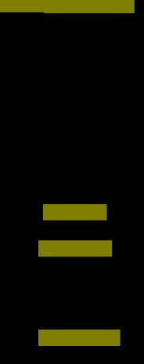
处理流程，关键数据结构和功能
■ 关键数据结构 (\kern\mm\vmm.h)
虚拟内存空间
物理内存空间
mm_struct
二级页表结构
物理页帧
mmap_struct
“合法”的虚拟页
prev
next
物理页帧
vma_struct 1
page in vma 1
vm_mm
page in vma 1
物理页帧
list_link
prev
next
空闲物理页帧
vma_struct 2
page in vma 2
vm_mm
page in vma 2
物理页帧
list_link
prev
next
page in vma 2

Slide 6

页访问异常
vectors.S:
vector14
find＿vma
get＿pte
trapentry.S
_alltraps
swapfs ＿read
swap＿in
trap
trap＿dispatch
pgfault ＿handler
do＿pgfault
page_ref＿inc
\kern\trap\trap.c
page＿insert
pgdir＿alloc＿page
Page＿remove ＿pte
swap＿map＿swappable
page＿ref

Slide 7

页访问异常
31
4 3 2 1 0
Reserved
I/D
W/R
P
U/S
RSVD
P
0 The fault was caused by a non-present page.
1 The fault was caused by a page-level protection violation.
W/R
0 The access causing the fault was a read.
1 The access causing the fault was a write.
U/S
0 A supervisor-mode access caused the fault.
1 A user-mode access caused the fault.
RSVD
0 The fault was not caused by reserved bit violation.
1 The fault was caused by a reserved bit set to 1 in some
paging-structure entry.
I/D
0 The fault was not caused by an instruction fetch.
1 The fault was caused by an instruction fetch.
Figure 4 – 12. Page-Fault Error Code

Slide 8

页换入换出机制
■
需要考虑的问题
应该换出哪个页？
如何建立虚拟页和磁盘扇区的对应关系？
何时进行页换入和换出？
如何设计数据结构支持页替换算法？
怎样进行页换入和换出？

Slide 9
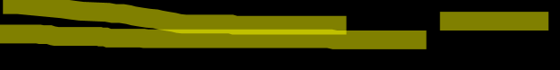
页换入换出机制
■
应该换出哪个页？
(\kern\mm\swap.c)
● Lab3: check_swap()
如何建立虚拟页和磁盘扇区的对应关系？
● PTE
swap_entry_t
offset
reserved
0
24 bits
7 bits
1 bits

Slide 10
页换入换出机制
■
页替换算法
FIFO: First In First Out (Lab3-2)
Clock
Enhanced Clock

Slide 11

页换入换出机制
■
何时进行页换入和换出？
换入（Swap in）: (kern\mm\swap.c)
check_swap() page fault do_pgfault()
换出（Swap out）
主动策略
被动策略 (ucore)

Slide 12
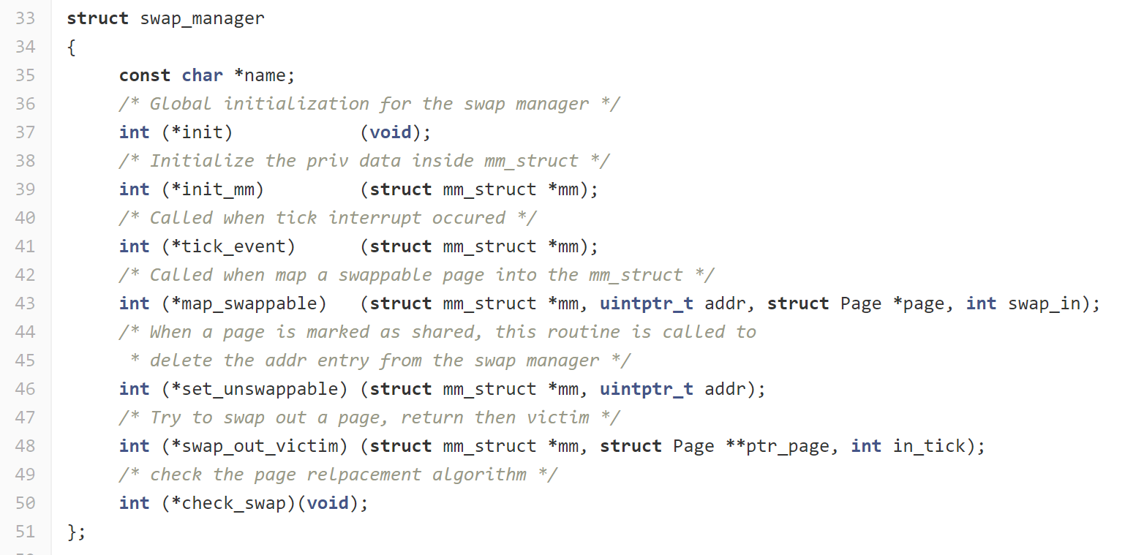

机制与策略的代码实现→接口定义
kern/mm/swap.h

Slide 13

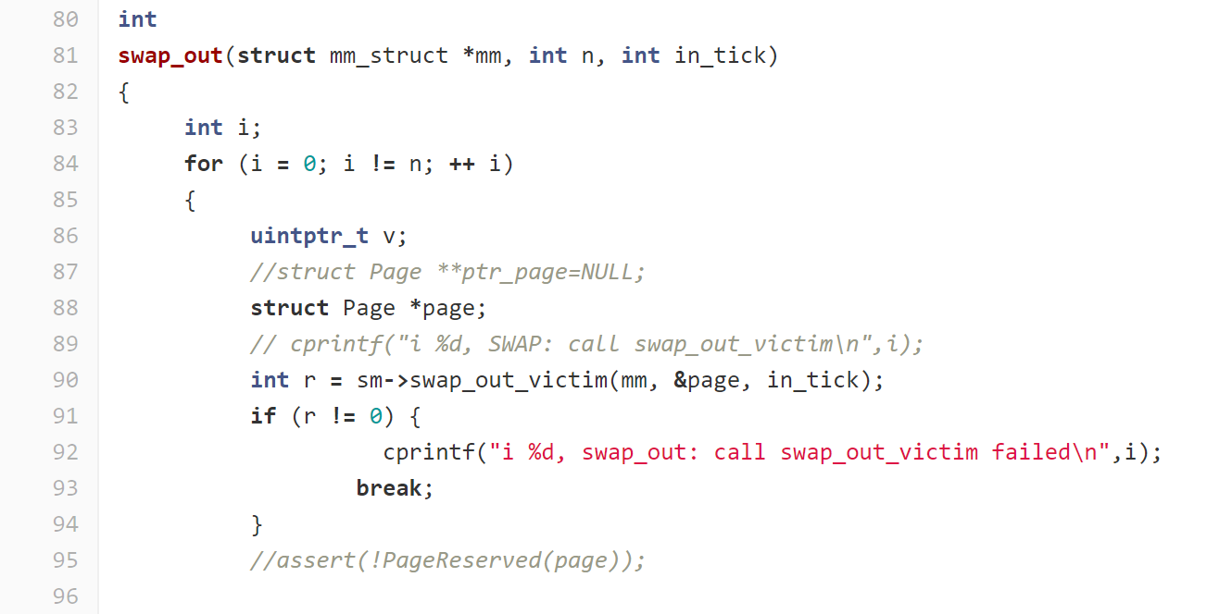
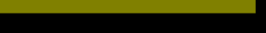
机制→固定的调用点和调用序列
kern/mm/swap.c

Slide 14
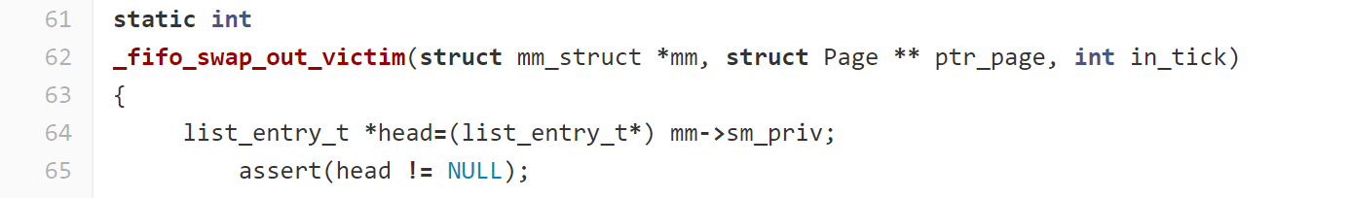
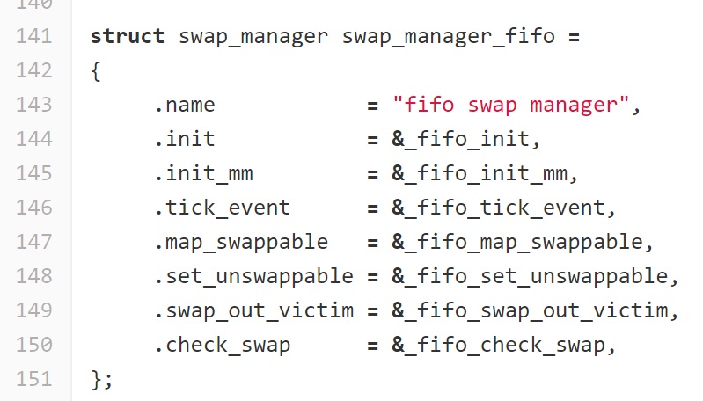

策略→自由地实现相应的函数接口
kern/mm/swap_fifo.c

Slide 15
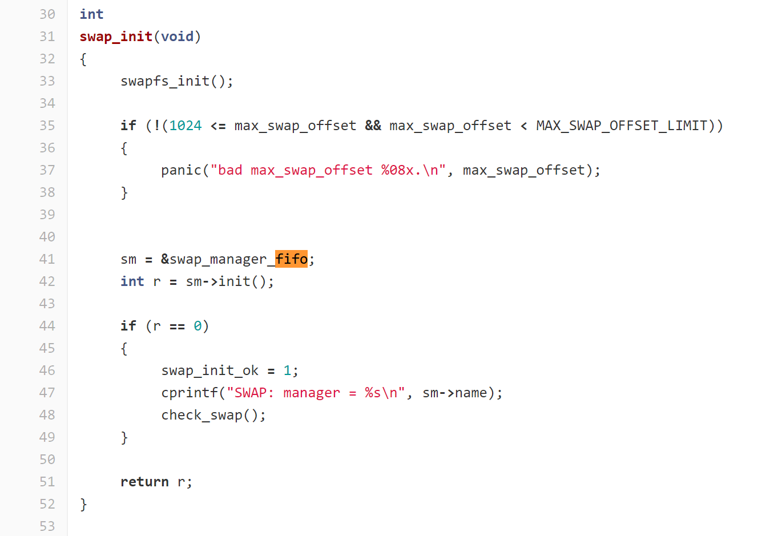
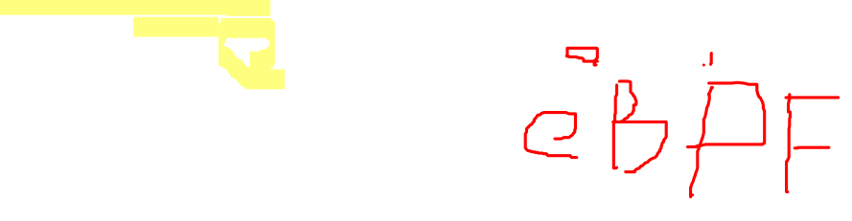
机制不变，改变策略
kern/mm/swap.c

Slide 17
祝编码愉快

